Slide 1

Water Point Commitee (W.P.C)
This user guide will help you navigate to this console. And display the features available.

Slide 2
How to access the console?
Access the mWater portal.
Access the HANWASH portal.

Slide 3
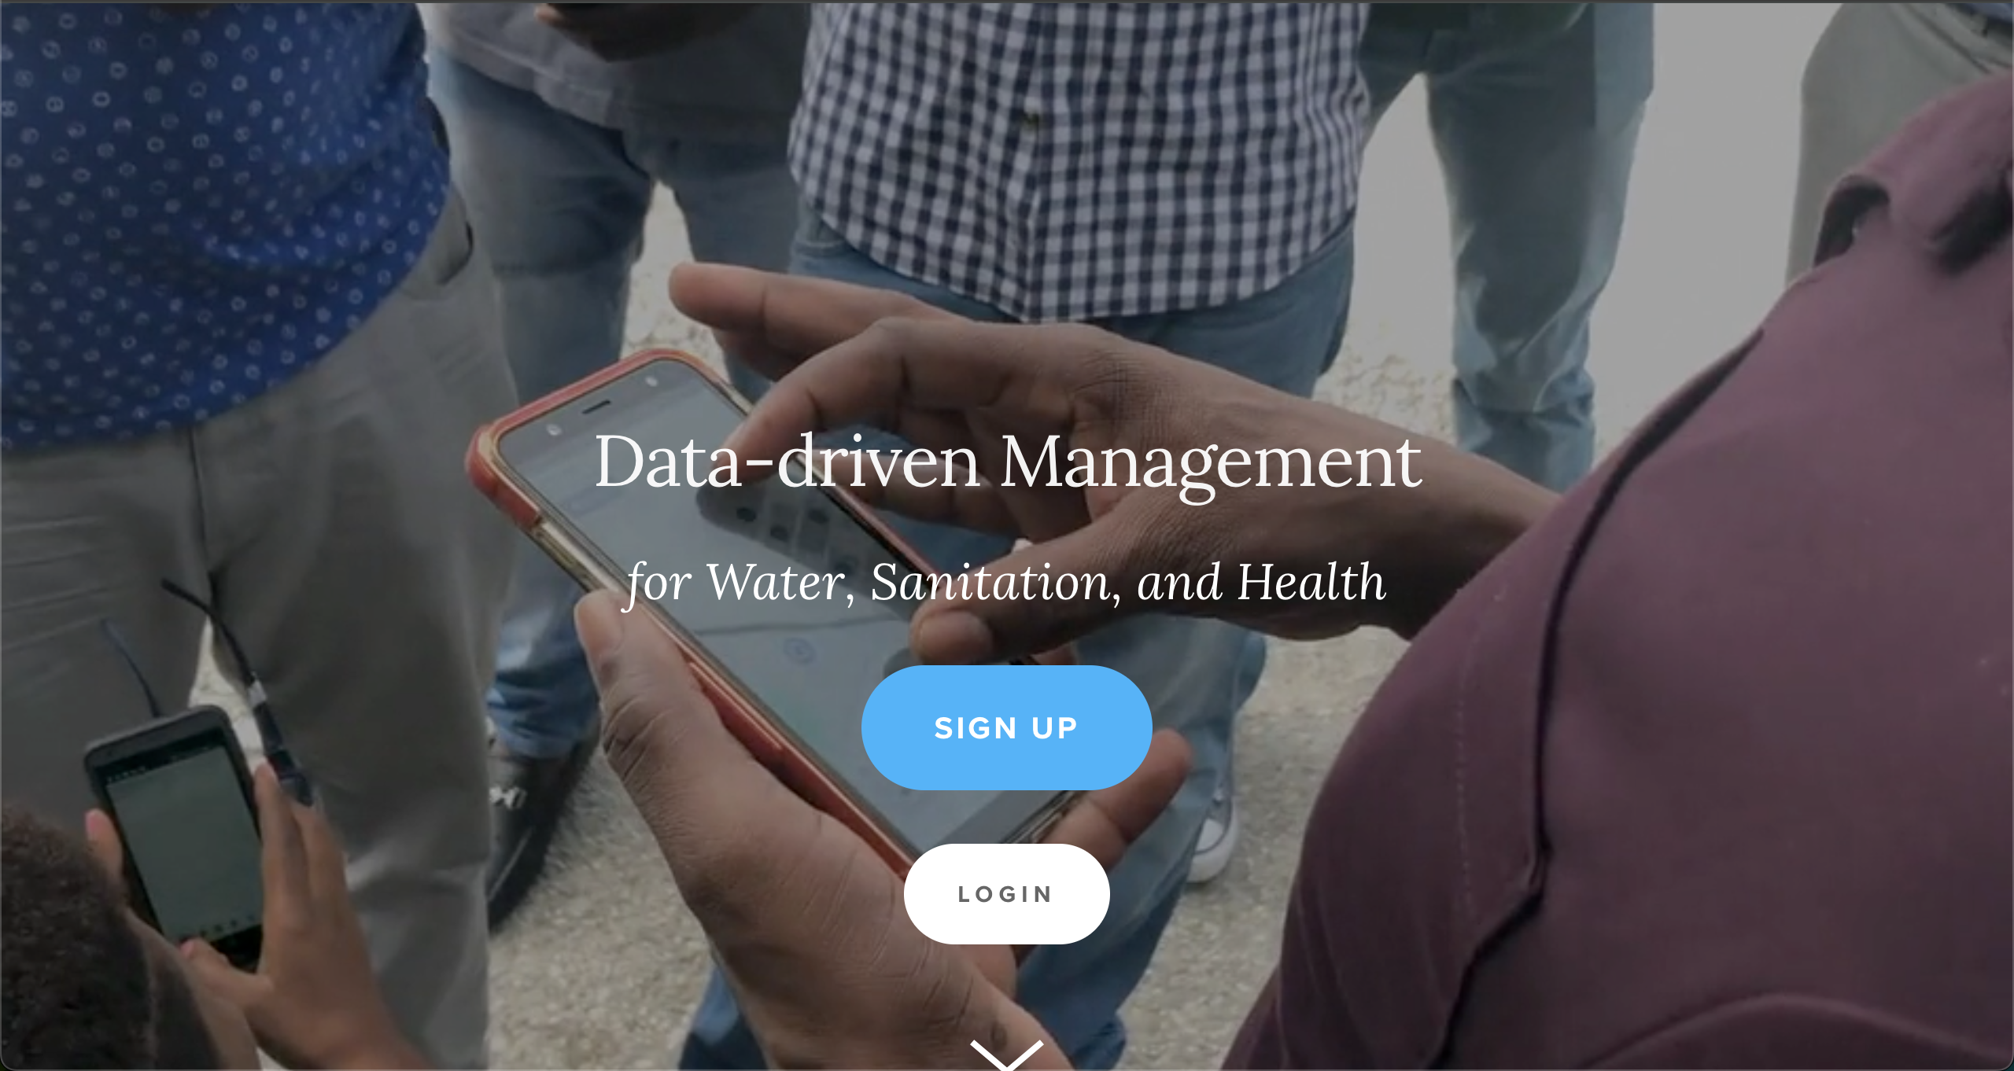
Mwater Home
URL LINK : https://www.mwater.co

Slide 4
Authenication PRocess
Click on the Login button.

Slide 5
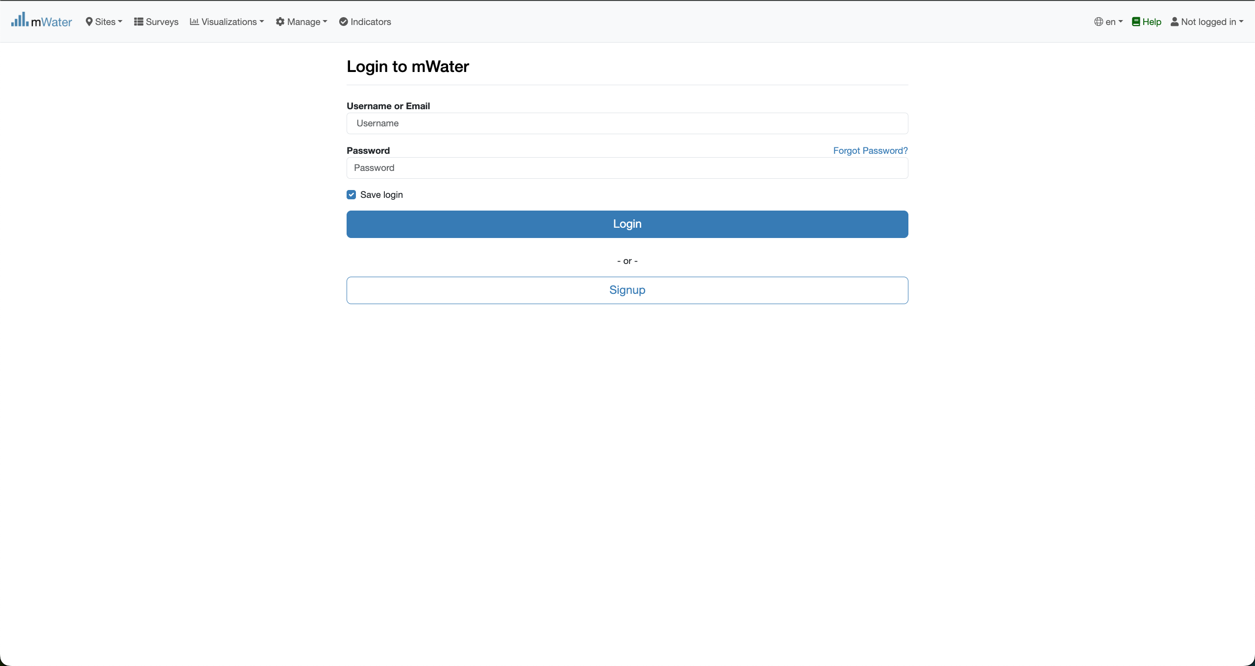
Authentication PRocess
You are not logged in.
Fill with your credentials and click on the log button.

Slide 6
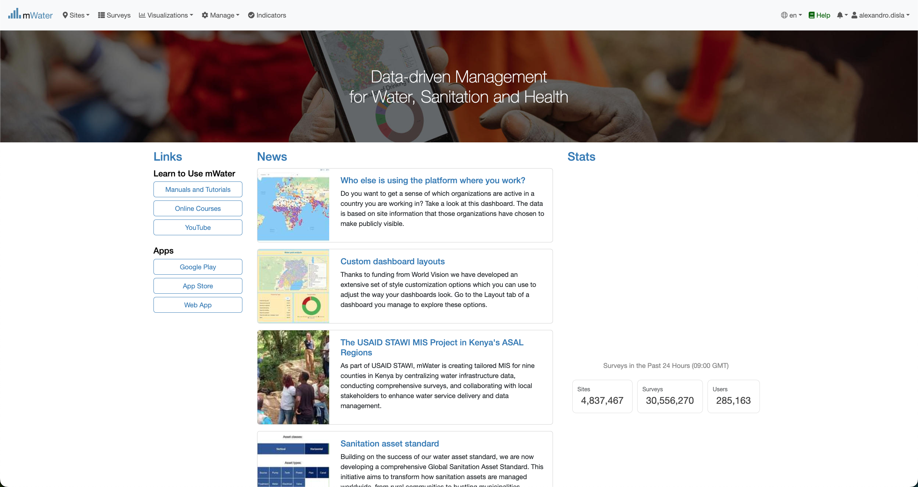
Mwater Home page Portal
You have successfully logged in.

Slide 7
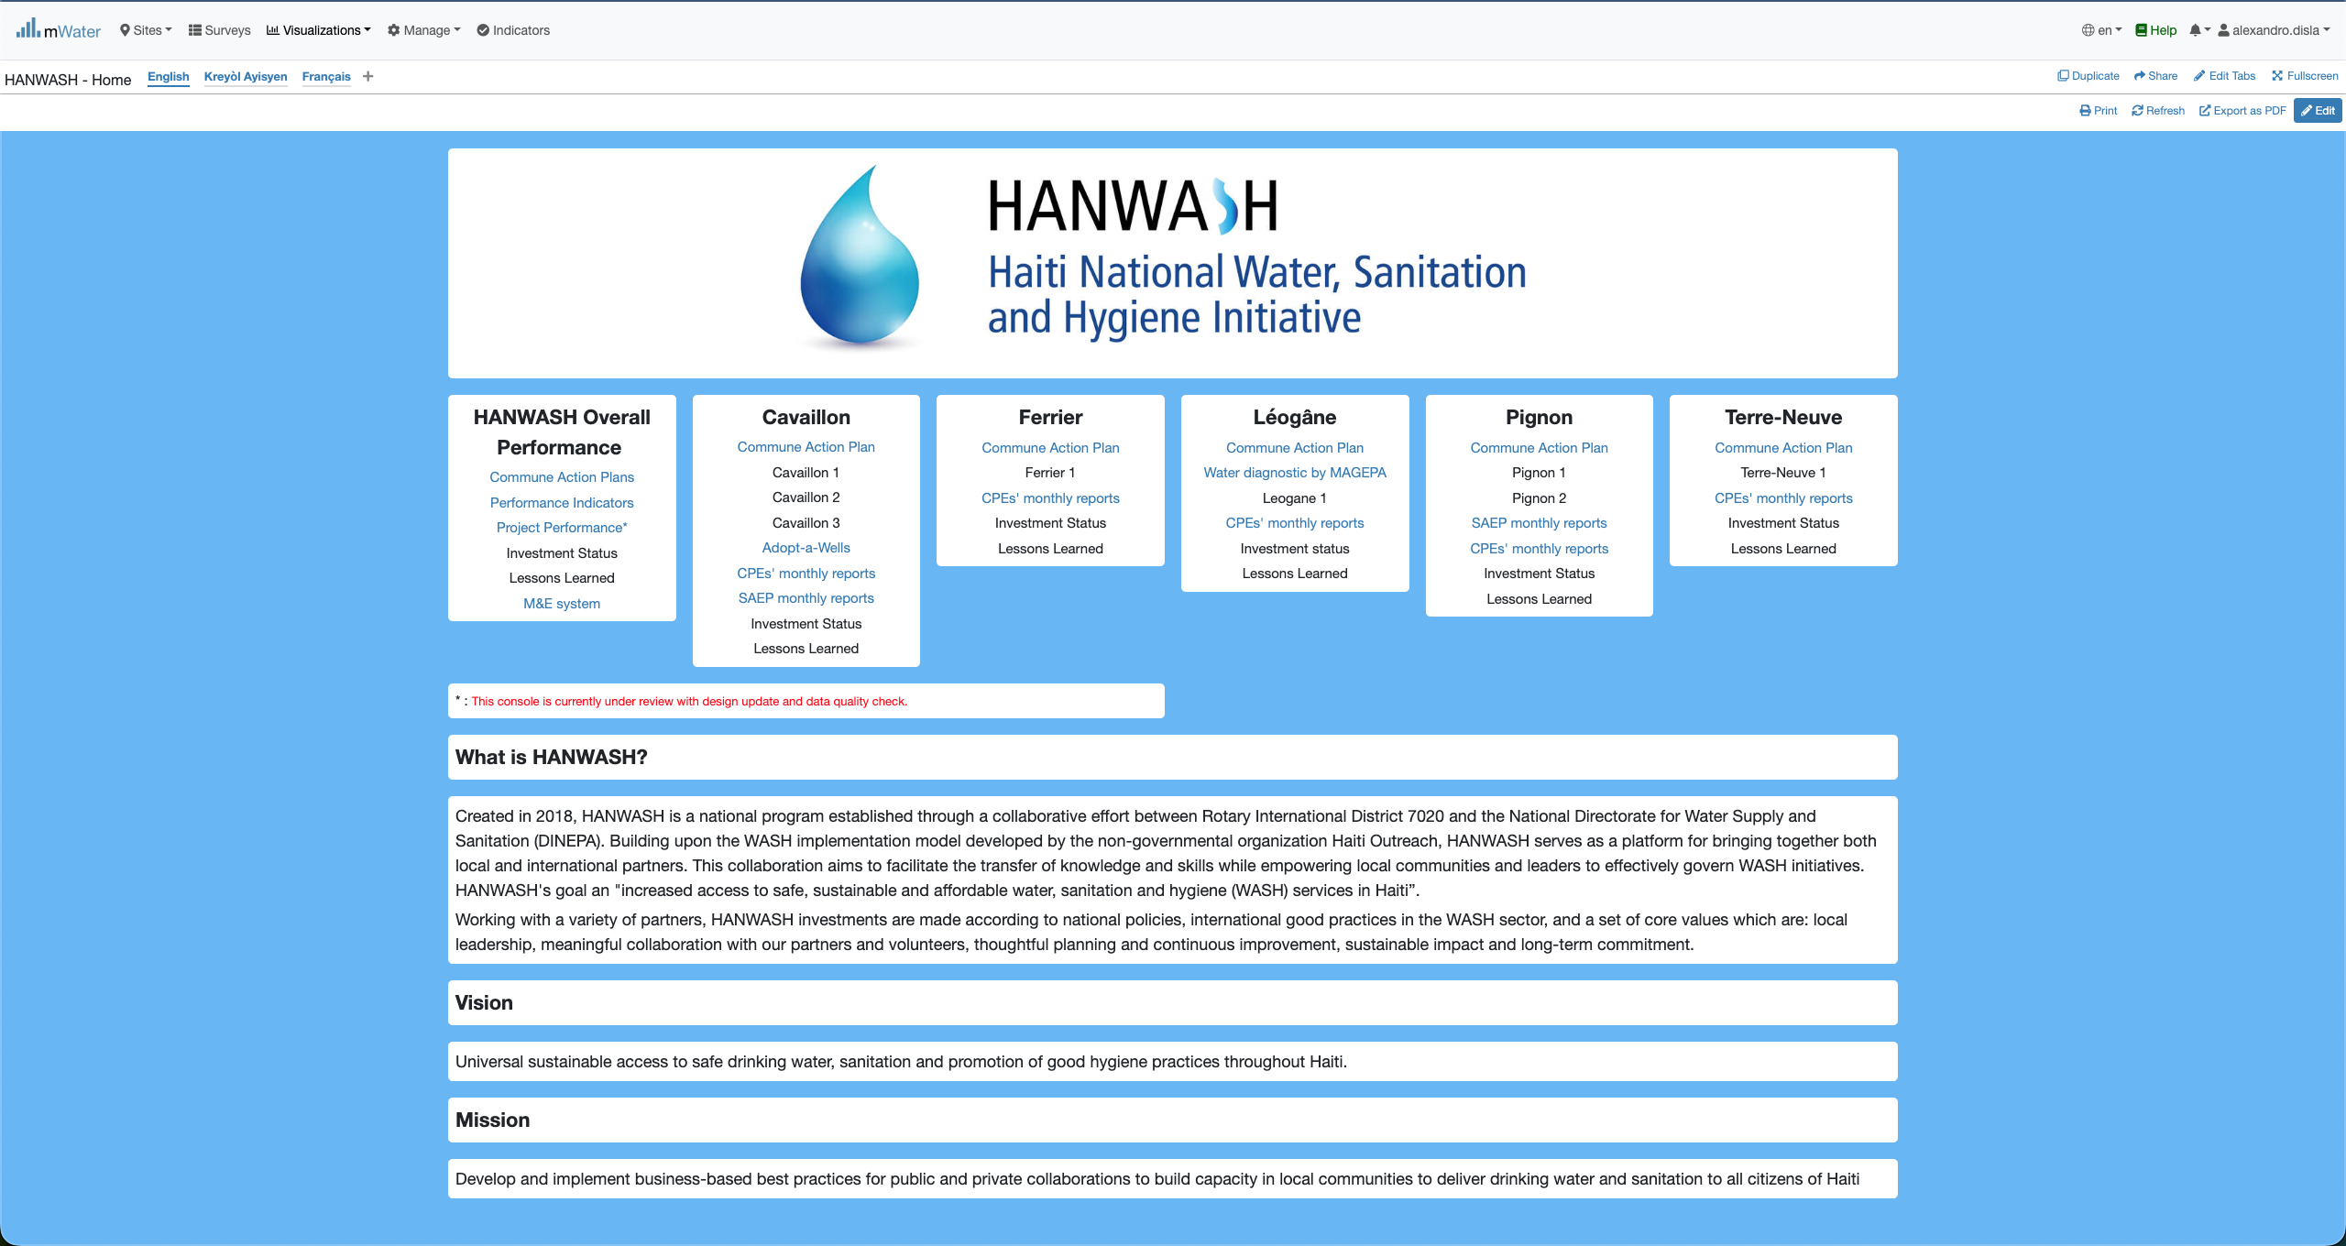
Hanwash HOME
After you have been logged in mWater. Please use this link in your browser to access the HANWASH HOME CONSOLE, quickly.
URL LINK : http://go.mwater.co/hanwash

Slide 8
Access the CPE CONSOLES
Please select the CPE Monthly reports, highlighted by their respective commune. The text in blue are clickable links

Slide 9
Console Overview
We have two page in the console. Please select the version of your pleasing.
1. CPE Reports (English Version)
2. Rapport CPE (French version)
Please stay on the CPE reports page.

Slide 10
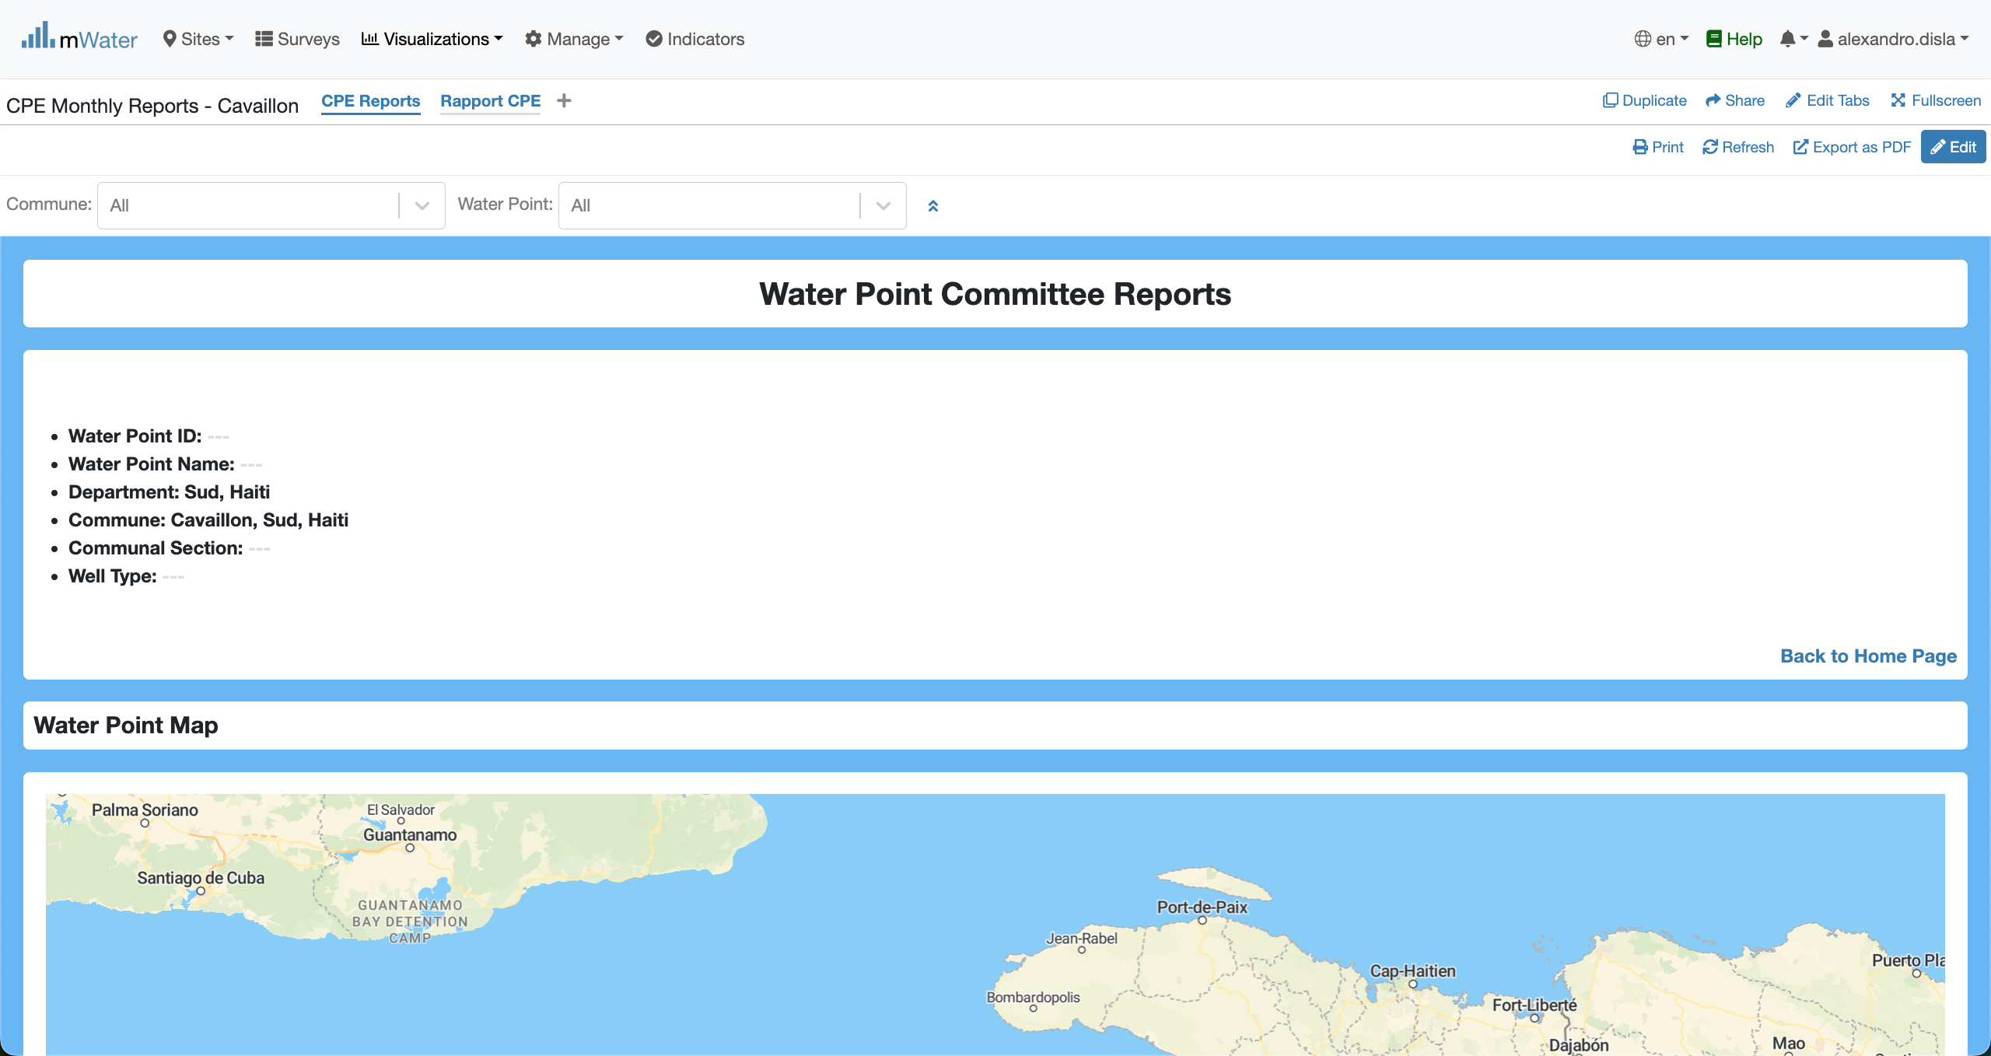
Console Overview
Please make sure that you are on the CPE Reports.

Slide 11
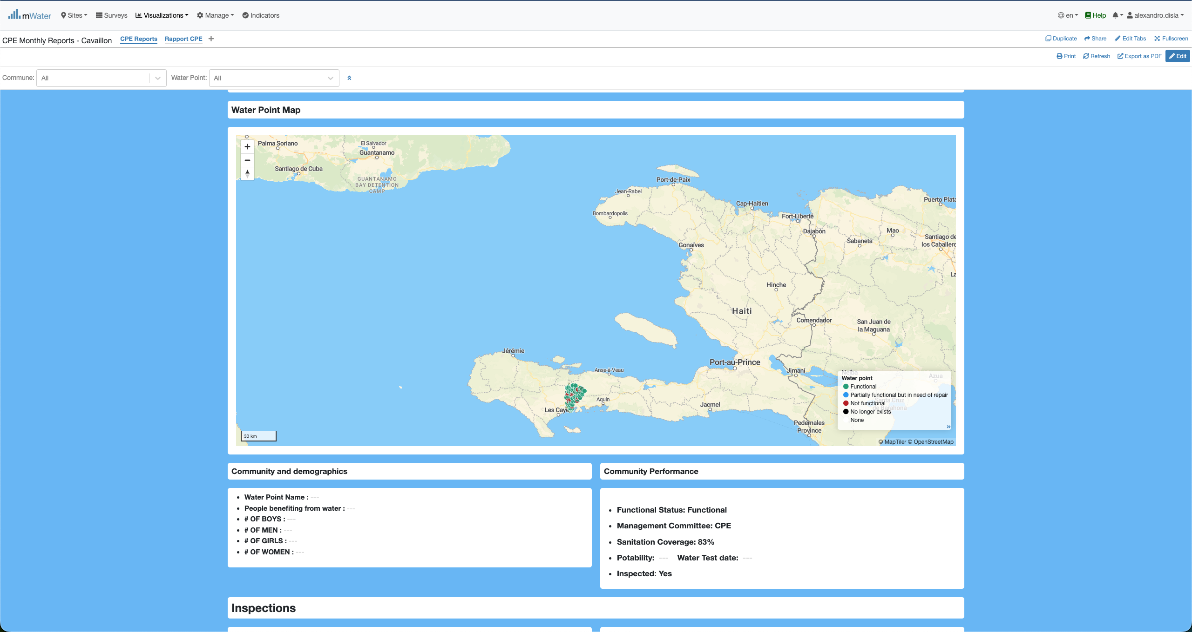
Console Overview

Slide 12
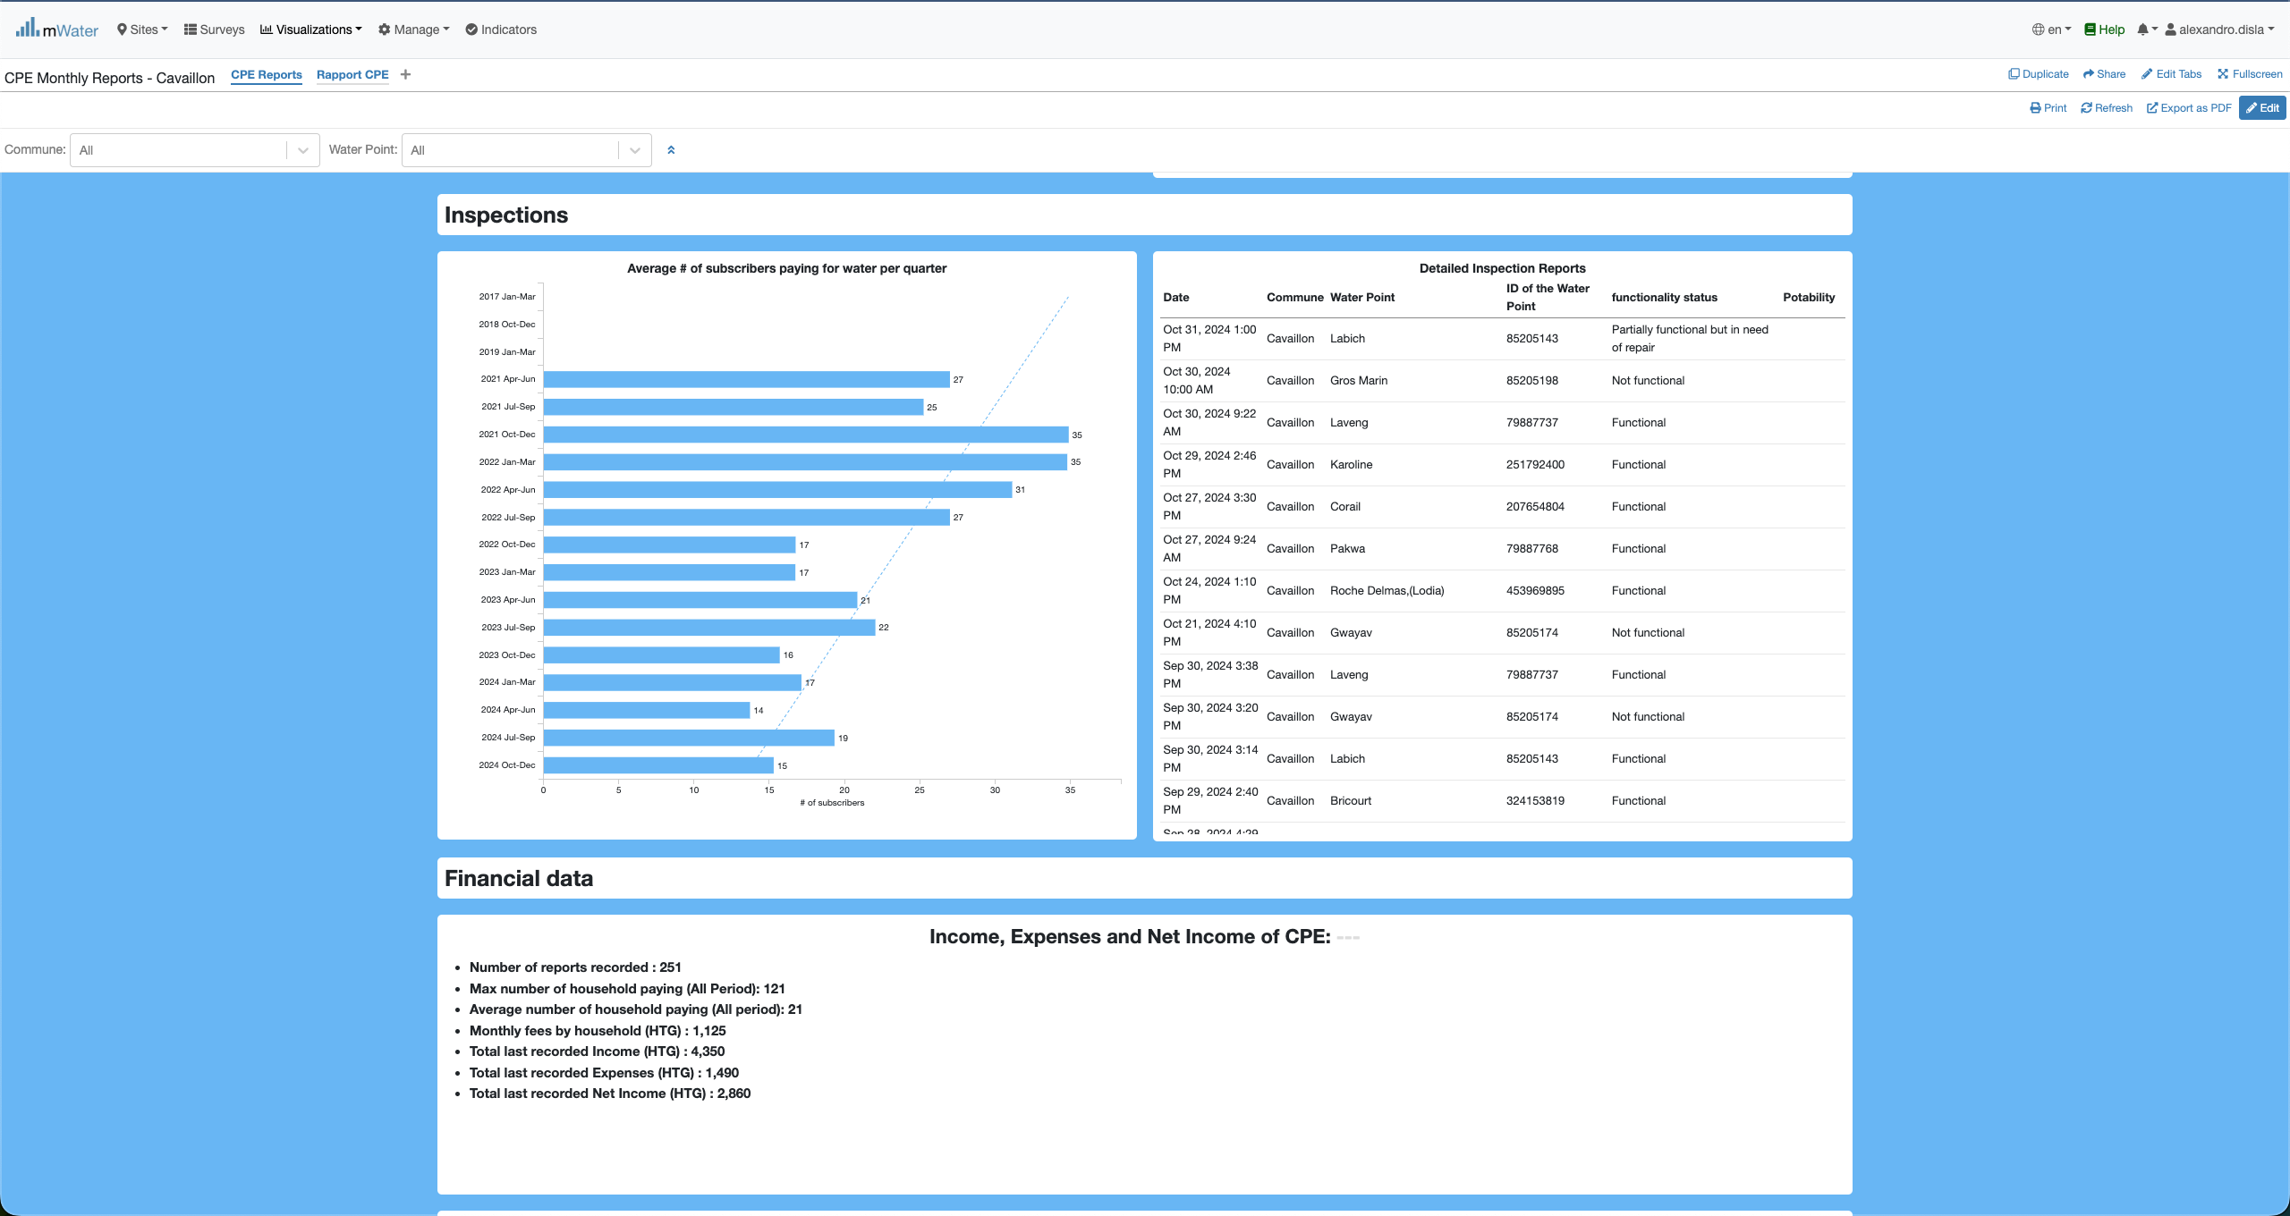
Console overview

Slide 13
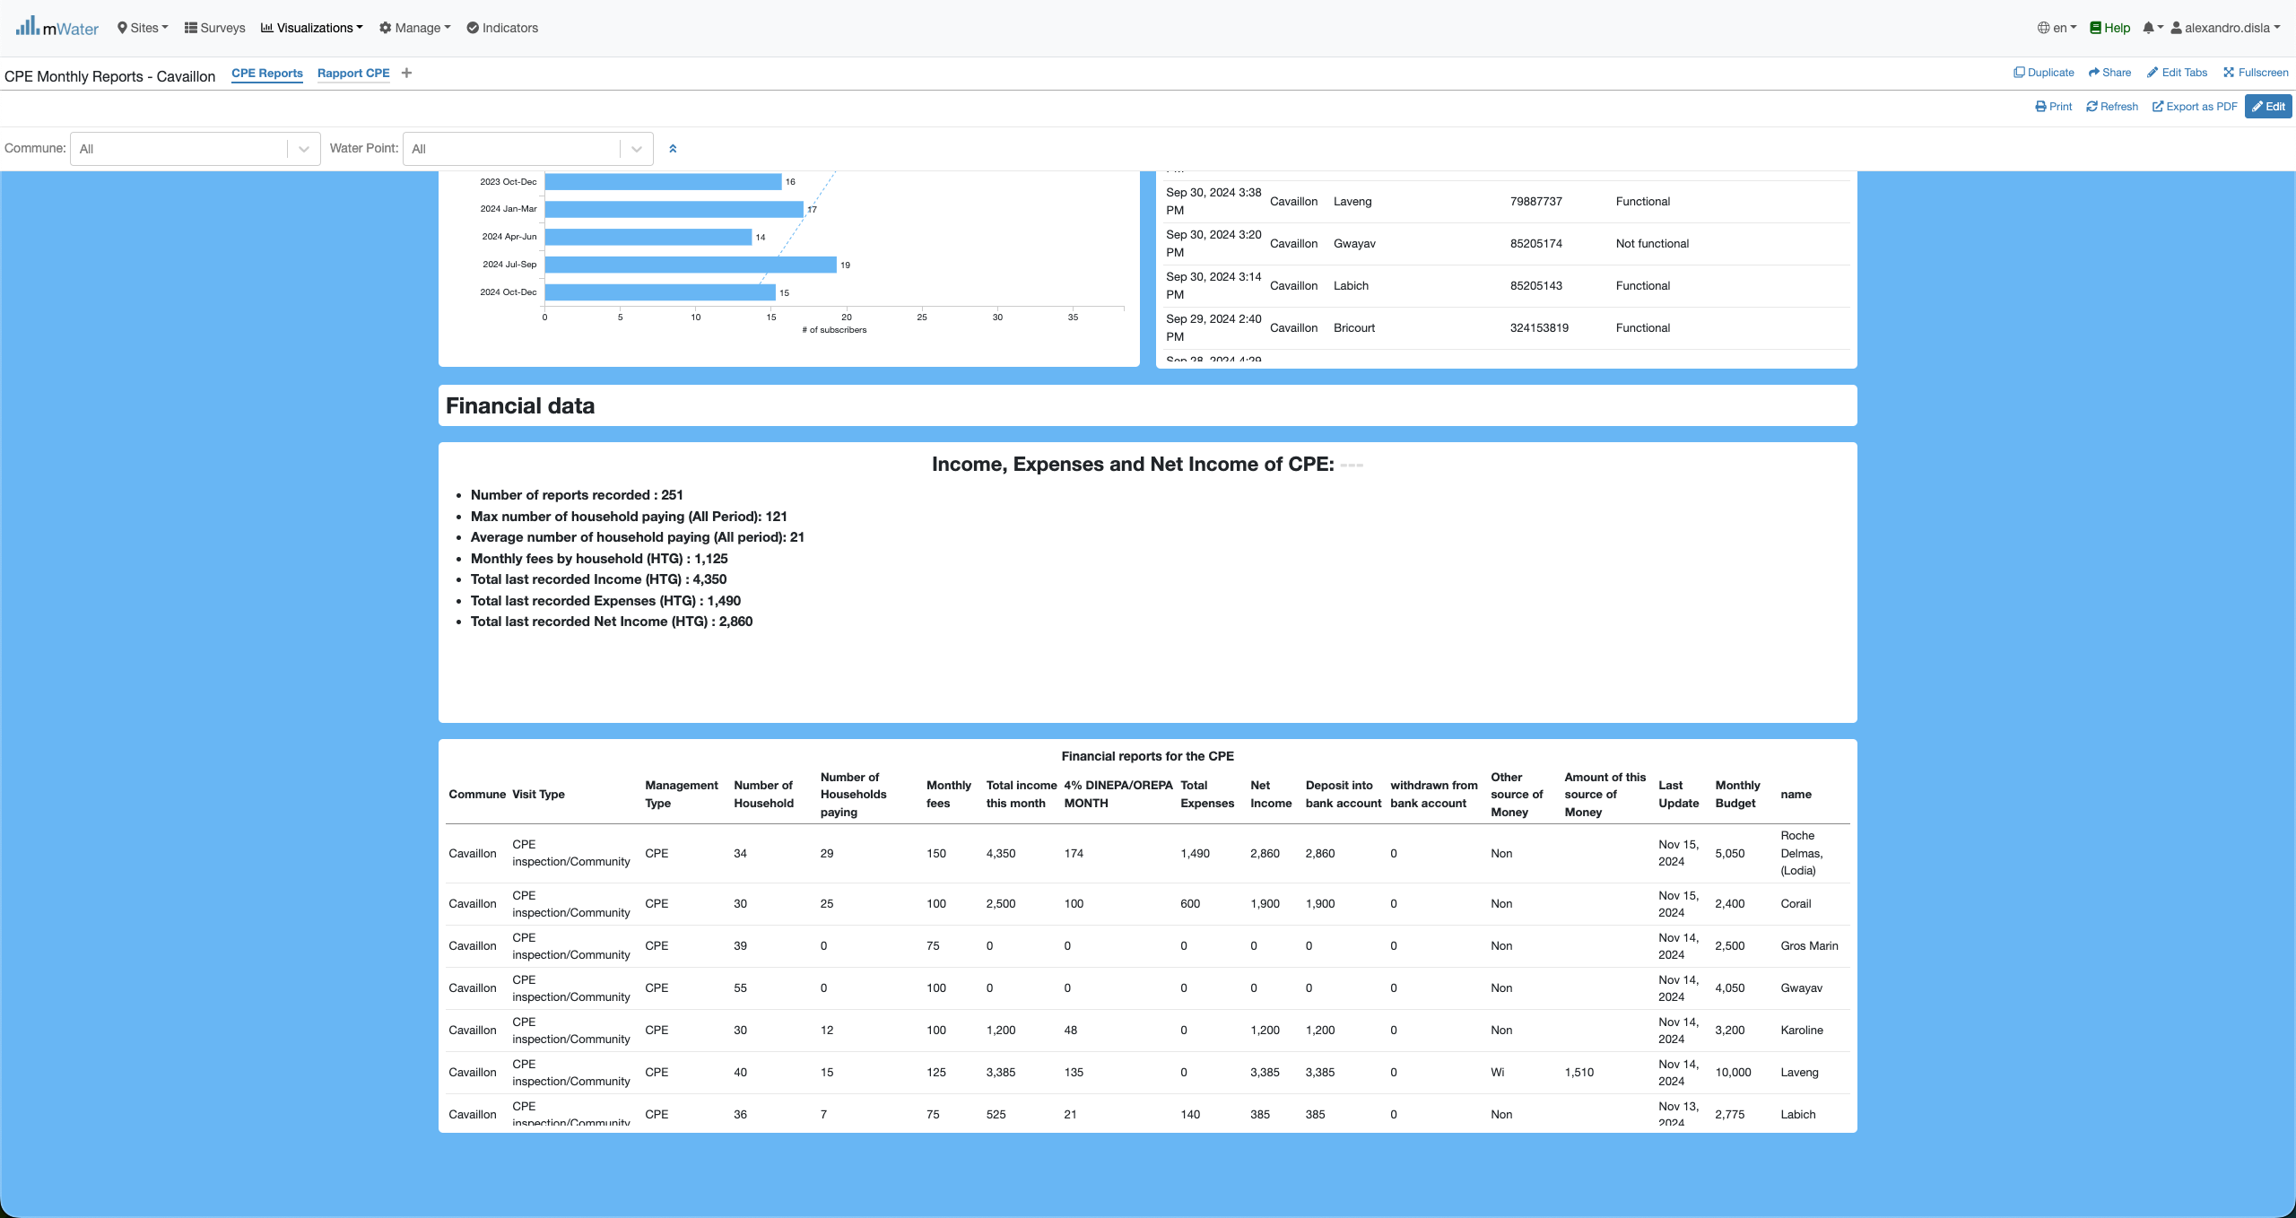
Console overview

Slide 14
Functionalities
What are functionalities available?

Slide 15
CPE REPORTS
SAEP Monthly Reports:
General Information
SAEP Operations
Subscribers
Connections
Water Production & Distribution
Financials

Slide 16
Export

Slide 17
Thank You !!!
PLEASE FEEL FREE TO CONTACT ME BY :
Email / alexandro.disla@hanwash.org
Whatsap or Phone / +50941483700

